Slide 1
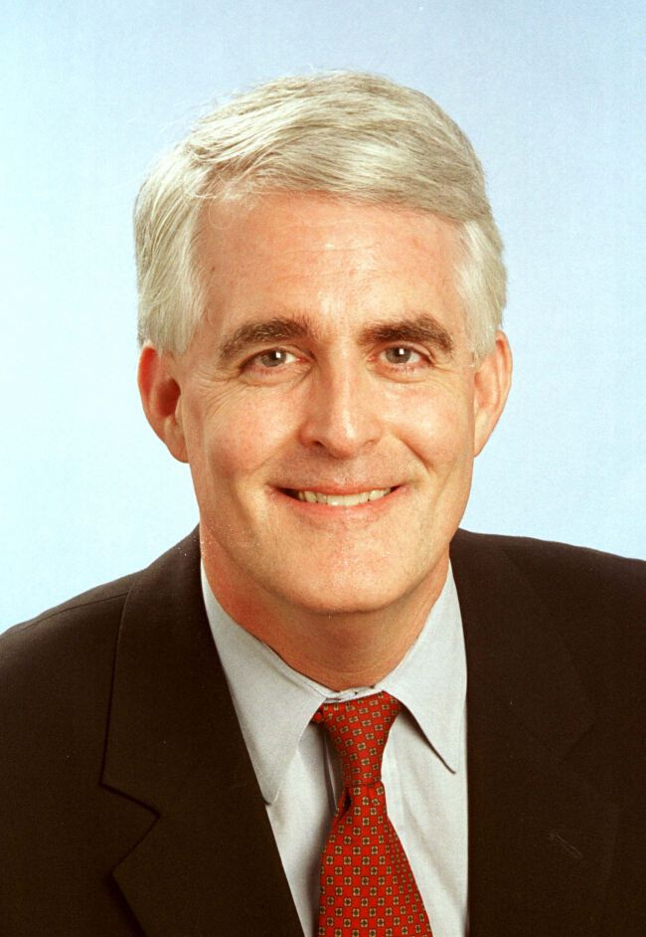

WORKING REMOTELY:
10 Quick Thoughts on Doing It Better
John Daly Ph.D.
UT McCombs School of
Business and Moody College
of Communication

Slide 2


Before We Get Started...
Everyone is on
mute, etc.
How to submit a question

Slide 3

John Daly Ph.D.
UT McCombs School of Business & Moody College of Communication
About The Speaker: Dr. John Daly is a renowned leader and author in interpersonal communication, persuasion and organizational behavior and advocacy. His work has been cited in many popular outlets including the Wall Street Journal, the Washington Post, Investors Business Daily, and the New York Times. He has advised several large public and private global companies and has worked with the White House (Executive Office of the President) At Texas Executive Education. Dr. Daly is a sought-after lecturer for corporate learning programs and teaches a range of courses including "Leading and Motivating Dispersed Teams".

Slide 4
A New World for Teamwork and Leadership: How to Work and Lead Dispersed Teams
John Daly
University of Texas
daily@austin.utexas.edu

Slide 5
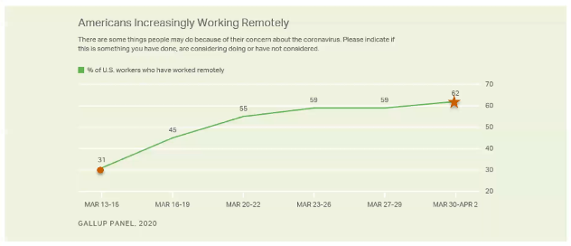
Working remotely has doubled since the start of the Coronavirus Pandemic

Slide 6
The Coronavirus experience has encourage people to continue working from home after it is resolved
Once restrictions on businesses and school closures are lifted, if your employer left it up to you, would you:
Work remotely as much as possible?
Return to work as your office as much as you previously did?
59%
41%

Slide 7
Dispersed Working Environments
Defining Distance Environments
DISTANCE
+
ACCESSIBILITY

Slide 8
Culture Matters
Keeping and Adapting the Organization's Culture
1.
Manage Identity
(How do you belong now?)
2.
Remind people of the purpose and mission both directly and indirectly
3.
Keep people connected. Create a community identity.

Slide 9

Performance Matters
✓ Goal Clarity
  Expectations; Goal Setting is vital (and the reasons why)
  Role specificity
  Outcome - metrics matterd a little bit of body text
✓ Evaluating Your People:
  Product vs. Process vs. Person
✓ Independent vs Interdependent Tasks
  Compartmentalizing tasks
✓ Maintain External Focus (e.g., customers)
  The who, the why, the how

Slide 10

Motivate
Rewards matter, especially spontaneous rewards
✓ Create punctuation marks
Markers of success- mini-celebrations
ex. Zoom meetings to celebrate milestones
✓ Design Motivational Tasks
What tasks are best done dispersed?
✓ Delegate decision-making
✓ Avoid false hope

Slide 11

Communicate
Information Availability & Regular Updates
Patience with Communication Technology
1. Not having the right technology
2. Beware: Don't attribute technology issues to people—don't confound people's tech skills with their abilities and performance
3. Not using technology appropriately
The Learning Curve:
*Forgetting or not understanding
•Mute button
•Background
•Distractions
*The challenges of email, audio/video conferencing
•Brevity matters
•Pauses in conversations
Virtual Workspace &
Collaborative Sharing

Slide 12
Communicate
✓ It's all about communication
✓ Focus matters
✓ Use multiple channels
Redundancy matters: email, Slack, phone, text, Zoom, WebEx...
✓ Documentation matters
✓ Managing the rumors
Virtual Workspace &
Collaborative Sharing
✓ Don't forget the "small" talk

Slide 13

Show You Care
How do your people know you care?
✓ Accessible and approachable
✓ Be interested in them and their challenges
✓ Understand the need for connection
✓ Surprise them, spontaneously
- "I care" packages
- Treats
- Fun virtual events (e.g., scavenger hunts on the web; home tours)

Slide 14


Build and Manage Teamwork
Dispersed is isolating
✔ Trust and Respect are crucial
✔ Watch language and comments
(we are more polite face-to-face)
✔ Let the fun begin
✔ Goofing off on Slack; Silly YouTubes
✔ Market the work of others
MARKETING PLAN 2020
✔ Assign specific responsibilities
✔ Conflicts last longer

Slide 15

Personalize Your
Leadership
✔ Know your people and let them know you, personally
✔ Tell stories (especially personal ones)

Slide 16

Personal Challenges
✓ Establish boundaries: Balance your life(when to turn work off)
✓ Practical Skills
  Go to work ( regular schedule; get dressed)
  Checklists each day
  Routines
  Breaks and exercise—move around more; sit less
  "Do not disturb" sign and a tension marker
  Have a view
  Partner and children issues (your spouse is not your co-worker)
  Avoid the bedroom
  Avoid the "COVID-15"

Slide 17
Personal Challenges
✓ Have a learning orientation
✓ Relational issues
✓ Mental health issues
  Depression is higher among work at home
  It is lonely (thus WeWork)

Slide 18


MARKETING PLAN 2020
Q&A
How to submit a question
John Daly Ph.D.
EXECUTIVE EDUCATION ONLINE COURSE
EXECUTIVE EDUCATION
ONLINE COURSE
Building Engagement:
What Leaders DO to Manage Talent and Building Allegiance
Leading & Motivating Dispersed Teams
May 7-8, 2020
June 2-3, 2020

Slide 19
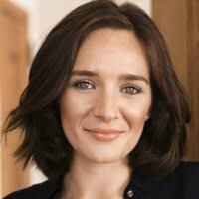
IN THE WFH ERA:
HOW LEADERS CAN
OPTIMIZE PERFORMANCE
Through Nutrition
Thursday, April 23rd
1:00 PM — 1:45 PM CDT
Marissa Epstein
Director of the UT Nutrition Institute and Lecturer in Management at the McCombs School of Business
IN THIS SESSION, DIETITIAN AND DIRECTOR OF THE UT NUTRITION INSTITUTE, MARISSA EPSTEIN WILL SHARE HOW STRATEGIC EATING GIVES AND EDGE FROM THE HOME OFFICE.
Free Webinar

